Slide 1


Phoenix Crime Data
Business Problem:
Crime is everywhere in cities and towns
Various dams that were created in the early to mid-1900s helped pave the way for Phoenix to become an economic hub
Starting in the 1960s and 1970s is when crime started to become rampant in parts of Phoenix
In the 1990s and beyond, many families and individuals relocated
Restaurants, bars, and companies started opening and/or relocating to Phoenix Metro area
Population was estimated, in 2018, to be 1.66 million people

Slide 2
Phoenix Crime Data
Hypothesis:
Phoenix, Arizona has various pockets where crime is high
Due to a number of factors within each ZIP Code:
Older dilapidated areas
Gangs are higher in certain areas
Low-income housing
Amount of rental units
High poverty rates

Slide 3
Phoenix Crime Data
Dataset Information:
Dataset used is from 2015 through 2021 Phoenix Crime Data
City of Phoenix Open Data website
Data includes:
INC_NUMBER
OCCURRED_ON (date and time the crime occurred on)
OCCURRED_TO (date and time the crime lasted)
UCR_CRIME_CATEGORY (main crime category)
ONEHUNDRED_BLOCK_ADDR (area where the crime occurred)
ZIP, and PREMISE_TYPE (area where the crime occurred)
There are 351,542 records in the Crime Data dataset

Slide 4
Phoenix Crime Data
Methods:
Exploratory data analysis (EDA)
“Exploratory Data Analysis refers to the critical process of performing initial investigations on data so as to discover patterns, to spot anomalies, to test hypothesis and to check assumptions with the help of summary statistics and graphical representations” (Patil, 2018).
Data types, fields, and null values were evaluated
INC_NUMBER, OCCURRED_TO, and ONEHUNDRED_BLOCK_ADDR field were removed
Any null values were removed
Zeros in the ZIP Code were removed

Slide 5
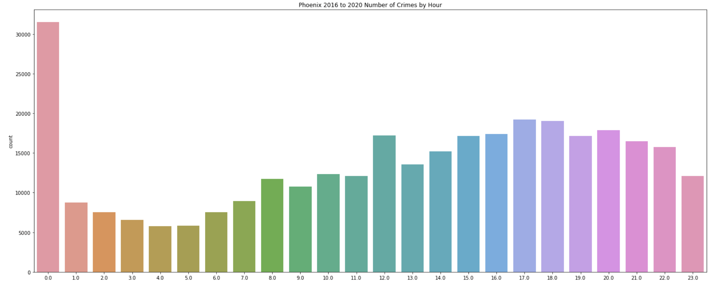
Phoenix Crime Data
Methods:
Year, month, hour, and dayofweek fields were created
2016 through 2020 data was used
Different fields were looked at to see if there was any correlation
Zeros in the ZIP Code were removed
Crime between 12 AM and 12:59 AM was the highest

Slide 6
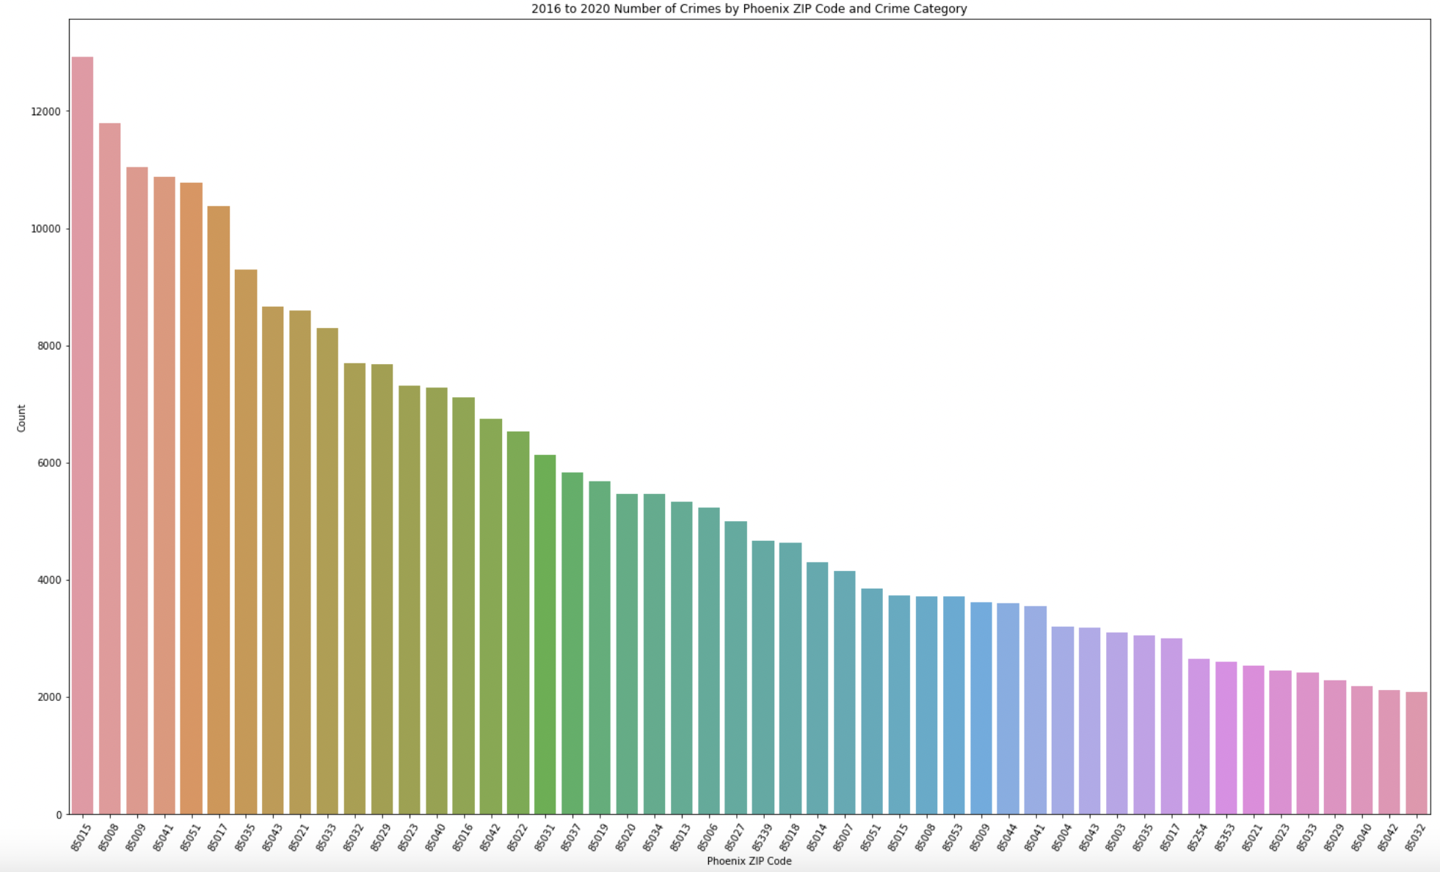
Phoenix Crime Data
Methods:
There were not very many different between the amount of reported crime between 2016 and 2020
Between those years, Phoenix crime hovered between 63,000 and 68,000
2018 had the highest amount of crime with about 68,000 reported crimes
85015, 85008, 85009, 85041, and 85051 were mainly the same top 5 ZIP Codes that had the highest crime

Slide 7
Phoenix Crime Data
Data:
Year | ZIP Code | # of Crimes |  | Year | ZIP Code | # of Crimes |  | Year | ZIP Code | # of Crimes |  | Year | ZIP Code | # of Crimes |  | Year | ZIP Code | # of Crimes
2016 | 85032 | 2018 |  | 2017 | 85032 | 2184 |  | 2018 | 85033 | 2150 |  | 2019 | 85033 | 2150 |  | 2020 | 85023 | 2092
2016 | 85033 | 2031 |  | 2017 | 85021 | 2217 |  | 2018 | 85043 | 2266 |  | 2019 | 85043 | 2266 |  | 2020 | 85021 | 2142
2016 | 85021 | 2035 |  | 2017 | 85043 | 2317 |  | 2018 | 85021 | 2377 |  | 2019 | 85021 | 2377 |  | 2020 | 85017 | 2533
2016 | 85035 | 2164 |  | 2017 | 85035 | 2469 |  | 2018 | 85035 | 2379 |  | 2019 | 85035 | 2379 |  | 2020 | 85035 | 2654
2016 | 85017 | 2512 |  | 2017 | 85051 | 2646 |  | 2018 | 85017 | 2558 |  | 2019 | 85017 | 2558 |  | 2020 | 85043 | 2715
2016 | 85009 | 2554 |  | 2017 | 85017 | 2713 |  | 2018 | 85041 | 2758 |  | 2019 | 85041 | 2758 |  | 2020 | 85041 | 2929
2016 | 85041 | 2590 |  | 2017 | 85041 | 2795 |  | 2018 | 85051 | 2799 |  | 2019 | 85051 | 2799 |  | 2020 | 85009 | 3118
2016 | 85051 | 2661 |  | 2017 | 85009 | 2839 |  | 2018 | 85008 | 2942 |  | 2019 | 85008 | 2942 |  | 2020 | 85015 | 3206
2016 | 85008 | 3034 |  | 2017 | 85008 | 3304 |  | 2018 | 85009 | 2980 |  | 2019 | 85009 | 2980 |  | 2020 | 85008 | 3212
2016 | 85015 | 3448 |  | 2017 | 85015 | 3308 |  | 2018 | 85015 | 3374 |  | 2019 | 85015 | 3374 |  | 2020 | 85051 | 3278

Slide 8
Phoenix Crime Data
Data:
UCR_CRIME_CATEGORY
AGGRAVATED ASSAULT
ARSON
BURGLARY
DRUG OFFENSE
LARCENY-THEFT
MOTOR VEHICLE THEFT
MURDER AND NON-NEGLIGENT MANSLAUGHTER
RAPE
ROBBERY

Slide 9
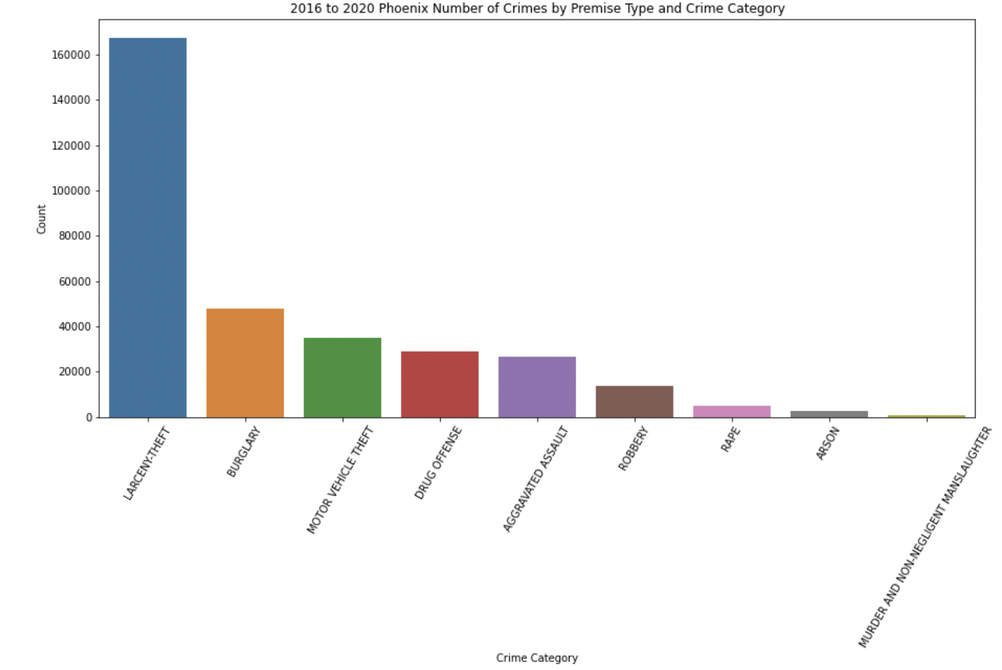
Phoenix Crime Data
Methods:
Larceny/Theft had the highest reported crimes

Slide 10
Phoenix Crime Data
Conclusion:
Highest crime reported was Larceny/Theft
Top 5 ZIP Codes for crimes stayed pretty much the same
Year over year between 2016 and 2020, reported crime was fairly close between each year
Top 5 areas where the most crime occurred (Premise Type) include single family houses, apartment, parking lot, street/roadway/alley/sidewalk, and retail business

